Slide 1
Sql Server 2000 (Language) and Stored Procedure
Training Session
By
Siddharth Kumar Sinha

Slide 2
Agenda
Day 1 –Introduction Of Sql Server 2000 and Database Concepts
Day 2 – Queries , Stored Procedure and Cursor

Slide 3
Day 1
Introduction Of Sql Server 2000 and Database Concepts

Slide 4
Database
A database is a place to store the data and really keep track of the data.
A database is a collection of information organized into related tables of data and definitions of data objects.
The data within a database can be easily accessed and manipulated trough computer program.

Slide 5
Relational database (RDBMS)
It is one that stores your data in multiple places called tables
It Is also keeping track of how those tables are related to one another.
MS SQL in particular store additional things in the database other then data.

Slide 6
SQL
What is SQL?
The Structured Query Language is used in manipulating data stored in (RDBMS).
SQL provides commands through which data can be extracted, sorted, updated, deleted and inserted.
SQL can be used with any RDBMS such as MySQL, Oracle, Microsoft SQL Server, Access, Sybase etc.
However, each has its own set of proprietary statements and extensions .

Slide 7
T-SQL
What is T-SQL?
T-SQL is SQL Server's enhanced version of the standard SQL programming language.
T-SQL in SQL Server 2000 allows for such things as stored procedures, IF and WHILE statements, and additional functions/data types, that are not available in standard SQL.

Slide 8
Sql server Introduction
DBMS system provided in co-venture of MS and Sybase.
Data stored in files _data.mdf and _log.ldf.
For client / server use.
It Accept Sql user request for data access and provide response against Request

Slide 9
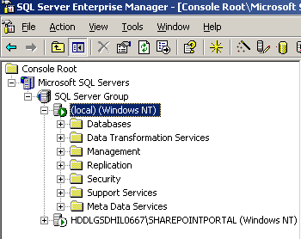
Enterprise Manager
It is the main administrative console for SQL Server installations. It provides you with a graphical "birds-eye" view of all of the SQL Server.

Slide 10
Enterprise Manager Allows Users To
Define groups of servers running SQL Server.
Register individual servers in a group.
Configure all SQL Server options for each registered server.
Create and administer all SQL Server databases, objects, logins, users, and permissions in each registered server.

Slide 11
Enterprise Manager Allows Users To
Define and execute all SQL Server administrative tasks on each registered server.
Design and test SQL statements, batches, and scripts interactively by invoking SQL Query Analyzer.
Invoke the various wizards defined for SQL Server.

Slide 12
Enterprise Manager Status
Enterprise Manager also provides you with a quick look at the status of your SQL Servers.
Server Running, You are currently connected
Server Running, You are not currently connected
Server Paused
Server Stopped

Slide 13
Query Analyzer
Quick method for performing queries against any of your
SQL Server databases.
Great way to quickly pull information out of a database in response to a user request.
Test queries before implementing them in other applications.
Create/modify stored procedures and execute administrative tasks.
The Execution Plan options graphically display the data retrieval methods .

Slide 14
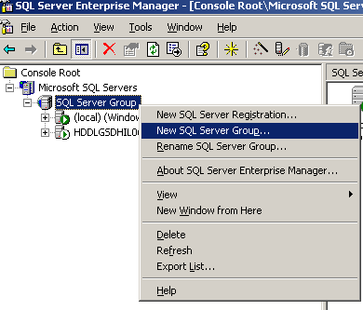
Adding a Sql Server Group

Slide 15
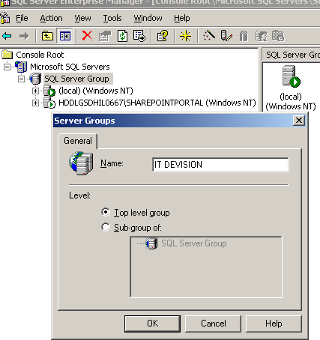
Adding a Sql Server Group

Slide 16
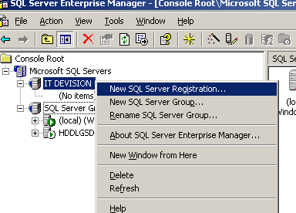
New Sql Server Registration

Slide 17
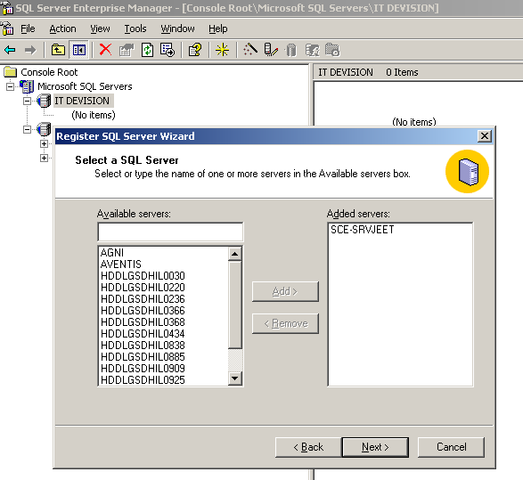
New Sql Server Registration

Slide 18
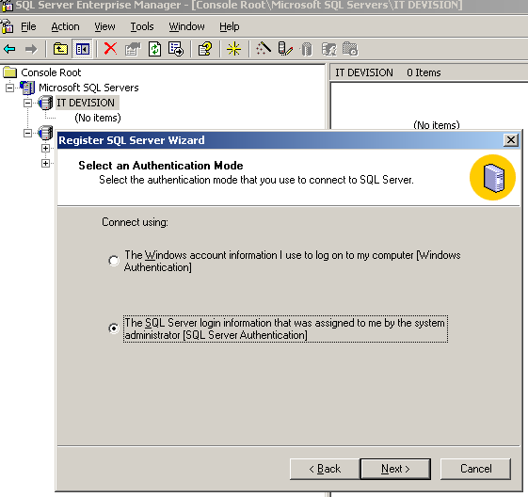
New Sql Server Registration

Slide 19
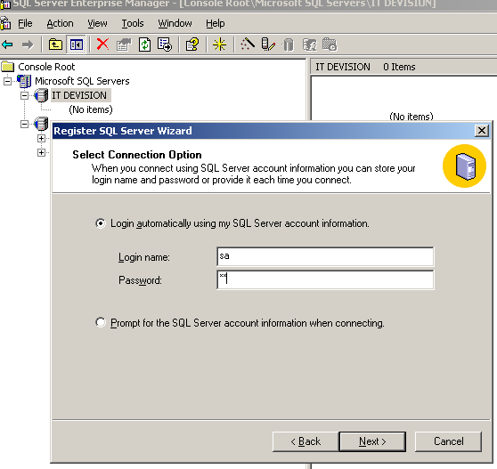
New Sql Server Registration

Slide 20
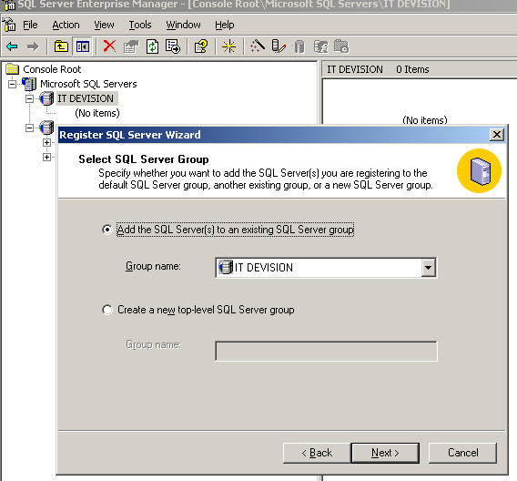
New Sql Server Registration

Slide 21
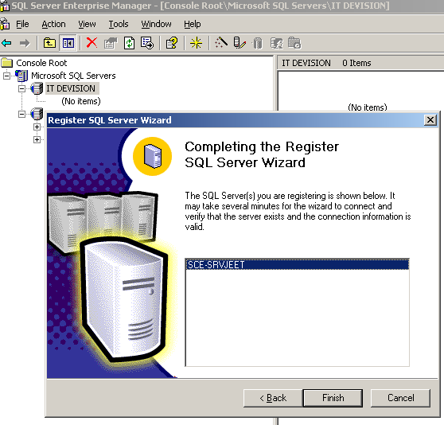
New Sql Server Registration

Slide 22
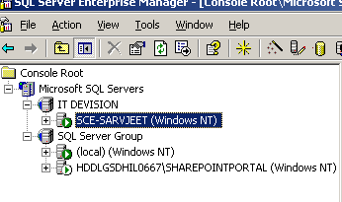
New Sql Server Registration

Slide 23
System Databases
master Database – Contains information about the server overall and all databases created. This includes: file allocations, disk space usage, system-wide settings, user accounts, and the existence of other databases and other SQL Servers.
model Database – This database provides a template for all newly created databases.

Slide 24
System Databases
msdb Database – Used by the SQL Server Agent service , Scheduling and Job Information.
tempdb Database – Is a workspace used for holding temporary information.

Slide 25
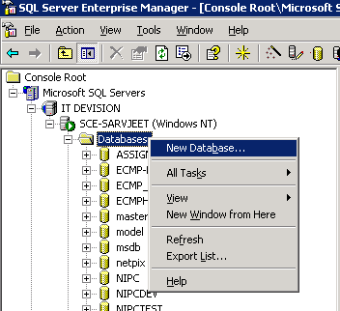
Create Database
In SQL SERVER We can create a new database with the help of wizard.
Right click on the Database folder on the selected Sql Server.

Slide 26
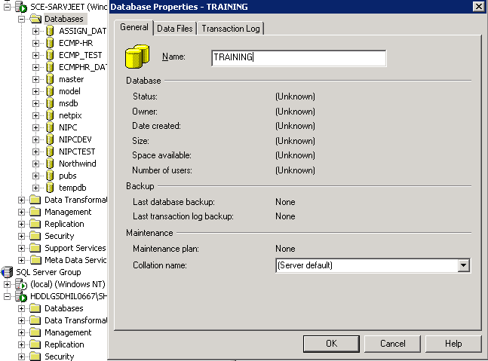
Create Database
In SQL SERVER We can create a new database with the help of wizard.
Right click on the Database folder on the selected Sql Server.

Slide 27
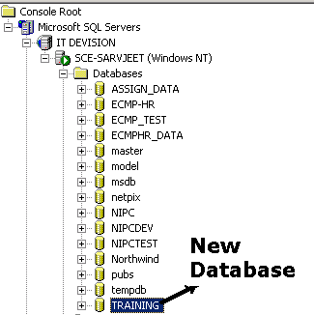
Create Database
Here We Have a New Database for our usage.

Slide 28
Create Database
CREATE DATABASE database_name
[ ON
[ < name> [ ,...n ] ]
[ < filespec > [ ,...n ] ]
[ , < size > [ ,...n ] ]
]
[ LOG ON
[ < name> [ ,...n ] ]
[ < filespec > [ ,...n ] ]
[ , < size > [ ,...n ] ]
]

Slide 29
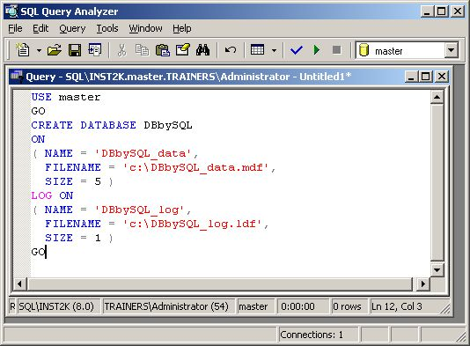
Create Database
In this case, we are adding a new database with Sql Query Analyzer by writing query so we use the master database. Next, the GO command tells SQL Query Analyzer to execute the current batch of Transact-SQL statements.

Slide 30
SQL Database Contains
Tables
Diagram
Views
Stored procedure
User
Roles
Rules
Default
User defined Data types
User defined Data Function

Slide 31
Table
Tables are objects that actually store the data. A Table in RDBMS refers to data arranged in rows and columns, which defines a database entity.
Each row represents a unique record.
Each column represents a field within the record.

Slide 32
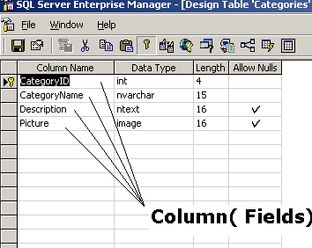
Column( Fields)
Database tables are made of different columns (fields) corresponding to the attributes of the object described by the table.

Slide 33
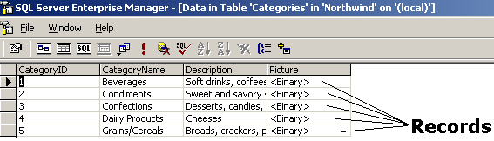
Records (Rows)
The record is a complete set of information presented within a RDBMS.
Records are composed of different fields (columns) in a table and each record is represented with a separate row in this table.

Slide 34
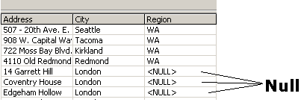
Null Values
The null value represent the absence of information<NULL>.
If the quantity for a particular record is null, the answer will also be null. As total cast will be null if single item’s cost is null.

Slide 35
Keys And Relationship
Candidate Key
It is an key that can be used to uniquely identify a record.
It may be used to retrieve one specific record.
It can be choose as primary key.

Slide 36
Keys And Relationship
Primary Key
A primary key is a set of columns from a table that are guaranteed to have unique values for each row of that table.
It is a candidate key that has been designated as the main key .
The key is also called a primary key constraint, because it effectively constrains the values you can add to the table.
The primary key of a relational table holds a unique value.
CREATE TABLE #t (x INT PRIMARY KEY)
Unique key may be NULL but Primary Key can not be Null.

Slide 37
Keys And Relationship
Foreign key
It is a correspondence between a set of columns in one table and the set of primary key columns in some other table.
The two participating tables are sometimes called the foreign-key table and the primary-key table.
A foreign key is also called a foreign key constraint because it constrains table rows.
It ensures that any row you add to the foreign-key table has a corresponding row in the primary-key table.
A foreign key is a key field (column) that identifies records in a table, by matching a primary key in a different table. The foreign keys are used to cross-reference tables.

Slide 38
Index
It is very similar to an index in a book.it provides a way to locate individual pages quickly.
An index on a table provides a way to locate an individual record quickly.
The data rows for each table or indexed view are stored in a collection of 8-KB data pages.

Slide 39
Index
Types of Indexes in SQL Server
Clustered-
The record is physically sorted.
It can’t be two on a single table.
Searching become fast ,Data manipulation become slow.
NonClustered-
only pointer information kept in an index.
It can be more than one on a table.
Data manipulation become fast but Searching become slow

Slide 40
Constraints
Constraints define rules regarding the values allowed in columns and are the standard mechanism for enforcing integrity .
Classes of Constraints
NOT NULL - column does not accept NULL values
CHECK - enforce domain integrity (value of specified range)
UNIQUE - enforce the uniqueness of the values (Primary keys )
PRIMARY KEY – Identify the column or set of columns whose values uniquely identify a row in a table.
FOREIGN KEY - Identify the relationships between tables .

Slide 41
Normalization
Normalisation is a theory for designing Relational Schema that “make sense” and work well.
Goals
    Eliminate redundant data
    Reducing NULLs
    Avoiding Unnecessary coding
    Keeping Table Thin

Slide 42
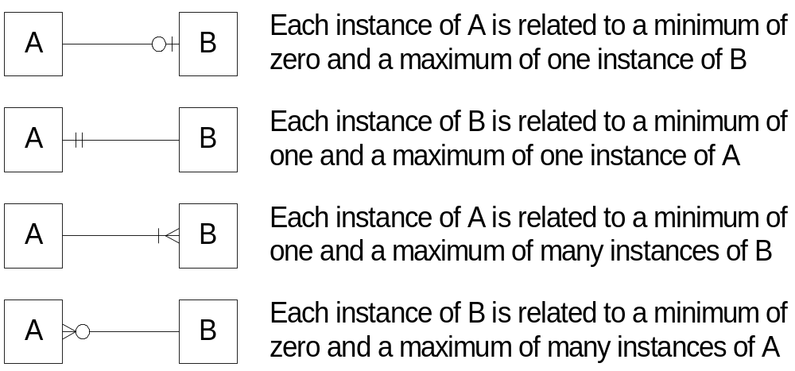
Normalization

Slide 43
Normalization
1st Normal Form
All attributes must be atomic that is Only one single value represent in a single attribute in a single instance of an entity.
All instances in a table must contain the same number of values.
All instances in a table must be different that is every 1st NF table have a Primary (unique) key

Slide 44
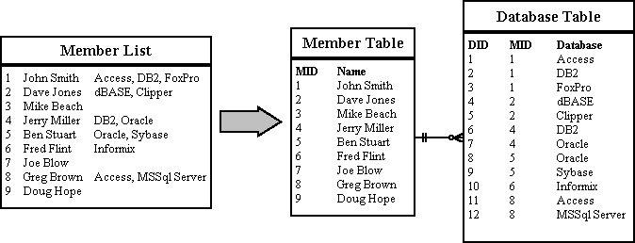
Normalization
1NF- Eliminate Repeating Groups - Make a separate table for each set of related attributes, and give each table a primary key.

Slide 45
Normalization
2nd Normal Form
  Entity must be in 1st Normal Form.
  Each Attribute must be fact describing the entire key. In other words every non key attribute must be functionally dependent on Primary Key.

Slide 46
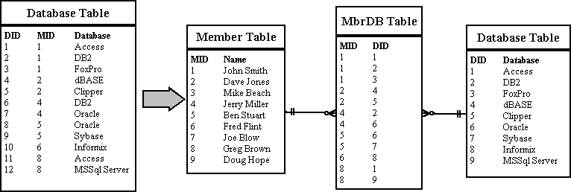
Normalization
2NF-Eliminate Redundant Data - If an attribute depends on only part of a multi-valued key, remove it to a separate table.

Slide 47
Normalization
3rd Normal Form
  Entity must be in 2nd Normal Form.
  Any entity is in violation of
      If a Non key attribute is functionally dependent on another Non Key attribute.

Slide 48
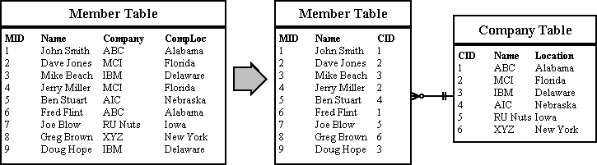
Normalization
3NF-Eliminate Columns Not Dependent On Key - If attributes do not contribute to a description of the key, remove them to a separate table.

Slide 49
Data Integrity
Data Integrity ensures the quality of the data in the database . Two
important steps in planning tables are to identify valid values for a
column and to decide how to enforce the integrity of the data in the
column .

Slide 50
Data Integrity
Entity Integrity
Entity integrity defines a row as a unique entity for a particular Table (through indexes, UNIQUE constraints, PRIMARY KEY constraints, or IDENTITY properties).
Domain Integrity
  Domain integrity is the validity of entries for a given column by restricting the type (data types), the format (CHECK constraints and rules), or the range of possible values (FOREIGN KEY constraints, CHECK constraints, DEFAULT definitions, NOT NULL definitions).

Slide 51
Data Integrity
Referential Integrity
Referential integrity preserves the defined relationships between tables when records are entered or deleted (through FOREIGN KEY and CHECK constraints).
User-Defined Integrity
User-defined integrity allows you to define specific business rules that do not fall into one of the other integrity categories.

Slide 52
DDL And DML
DDL statements- Most DDL statements begin with CREATE, ALTER, or DROP.
DML statements- Used for manipulating the data inside database objects. For example, the SELECT statement allows you to query the data inside a database, the INSERT statement allows for the addition of new data, the UPDATE statement updates selected data, and the DELETE statement allows you to remove data.

Slide 53
Operators
Operators Meaning
+ Addition, String Concatenation
- Subtraction
* multiplication
/ Division
% modulus
= assignment, equality
& AND
| OR

Slide 54
String Functions
  LEFT- Select character of the given length from left end of the string
  Print LEFT (‘abcdefg’,4) return abcd
  RIGHT- Select character of the given length from Right end of the string
  Print RIGHT(‘abcde’,3) return cde

Slide 55
String Functions
LOWER - Converts string to lowercase
LOWER(‘MiXed CasE’) Return mixed case
UPPER- Converts string to Uppercase
UPPER(‘MiXed CasE’) Return MIXED CASE

Slide 56
String Functions
RTRIM – Function remove trailing blanks
RTRIM(‘sql ‘) return ‘SQL’
LTRIM – Function remove heading blanks
LTRIM(‘ sql‘) return ‘SQL’

Slide 57
String Functions
LEN- Length of the character
LEN(‘abcdef’) return 6
REPLACE- Replaces instances of a string with another
REPLACE(‘abcdefg’ ,’abc’ ,’123’) Return 123defg
SUBSTRING – Return a specified no of cha. Starting at a specified point in a string.
Substring(‘ABCDEFG”, 4, 2) Return DE

Slide 58
Datetime Function
Constant meaning
  yy or yyyy year
  qq or q quarter
  mm or m month
  wk or ww week
  dd or d day
  hh hour
  mi or n minute
  ss or s Second
  ms MilliSecond

Slide 59
DateTime Functions
Print DATEPART (yy, getdate())
Print DATEPART (dd, getdate())
Print DATEPART (mm, getdate())
Print DATEPART (hh, getdate())
Print DATEPART (wk, getdate())

Slide 60
Mathematical Function
ABS
Returns the absolute, positive value of the given numeric expression.
SELECT ABS(-1.0), ABS(0.0), ABS(1.0)
Here is the result set:
---- ---- ----
1.0 .0 1.0

Slide 61
Mathematical Function
ASCII
Returns the ASCII code value of the leftmost character of a character expression.
Print ASCII('s') Return 115
CEILING
Returns the smallest integer greater than, or equal to, the given numeric expression.
SELECT CEILING($123.45), CEILING($-123.45), CEILING($0.0)
Here is the result set: --------- --------- -----------
124.00 -123.00 0.00

Slide 62
Mathematical Function
FLOOR
Returns the largest integer less than or equal to the given numeric expression.
SELECT FLOOR(123.45), FLOOR(-123.45), FLOOR($123.45)
Here is the result set: --------- --------- -----------
123 -124 123.0000

Slide 63
Mathematical Function
ROUND
Returns a numeric expression, rounded to the specified length or precision.
SELECT ROUND(123.9994, 3), ROUND(123.9995, 3)
Here is the result set:
----------- -----------
123.9990 124.0000

Slide 64
Mathematical Function
SQUARE
Returns the square of the given expression.
PRINT SQUARE ( 2) Return 4
SQRT
Returns the square root of the given expression.
PRINT SQUARE ( 4) Return 2

Slide 65
Mathematical Function
LOG
The LOG function returns the natural logarithm for the given float expression. Natural logarithms are calculated by using the base-2 system.
SELECT LOG(1.75) Return 0.55961578793542266
LOG10
LOG10 function returns the base-10 logarithm.
SELECT LOG10(1.75) Return 0.24303804868629444

Slide 66
System Functions
These scalar functions perform operations on and return information about values, objects, and settings in SQL Server.
CAST and CONVERT
Explicitly converts an expression of one data type to another. CAST and CONVERT provide similar functionality.
SELECT CAST ('abc' AS varchar(30)) return abc
SELECT CONVERT(varchar(30),'abc') return abc
SELECT CONVERT(DateTime,’01/01/2006‘, 107 )

Slide 67
System Functions
HOST_NAME
Returns the workstation name.
Print HOST_NAME ( )
ISNULL
Replaces NULL with the specified replacement value.
SELECT ISNULL (‘HCL TECHNOLOGIES',’HCL')

Slide 68
System Functions
SYSTEM_USER
Allows a system-supplied value for the current system username to be inserted into a table when no default value is specified.
SELECT SYSTEM_USER return HCLGGN\ UserID
NEWID
Creates a unique value of type uniqueidentifier.
Select NewID()

Slide 69
Local Variables
Sets the specified local variable.
DECLARE @varCUST_ID VARCHAR(30)
DECLARE @intCOUNT Int
SELECT @varCUST_ID = ’HCL’
SELECT @intCOUNT =5
PRINT @varCUST_ID
PRINT @intCOUNT

Slide 70
Day2
To Be Continued…
Queries , Stored Procedure and Cursor

Slide 71


